Slide 1
CURE: Clustering Using REpresentatives algorithm
University of Belgrade
School of Electrical Engineering
Department of Computer Engineering
Student: Uglješa Milić
Email: mu113322m@student.etf.rs
Belgrade,
December 2011

Slide 2
Agenda
Introduction
- About clustering
- Previous approaches
- Things to improve
CURE algorithm
- Basic ideas
- Step by step
- Experimental results
Conclusion
Q&A
1/15

Slide 3
Introduction
About clustering
Classification of objects into different groups
Those who uses partitioning or hierarchical techniques
Partitioning - starts with one big cluster and downward step by step reaches the number of clusters we wanted
Hierarchical - starts with single point cluster and upward step by step merge cluster until desired number is reached
The second technique is used in this work
2/15

Slide 4
Introduction
Previous approaches
All-points approach
Any point in the cluster is representative of the cluster
where d_{min} stands for minimum distance between two points of a pair of clusters
d_{min}(C_{a}, C_{b}) = minimum( || p_{a,i} – p_{b,j} || )
3/15

Slide 5
Introduction
Previous approaches
Centroid-based approach
Considers one point as representative of a cluster - centroid
where d_{mean} stands for a distance between two centroids
d_{mean}(C_{a}, C_{b}) = || m_{a} – m_{b} ||
4/15

Slide 6
Introduction
Things to improve
Hierarchical models are typically fast and efficient
As a result they are also popular
Some disadvantages of traditional clustering algorithms:
- favor clusters approximating spherical shapes
- similar sizes
- poor at handling outliers
5/15

Slide 7
CURE algorithm
Basic ideas
Introduce balance between centroid and all-points techniques
Presents a hybrid of the two
Pre-defined number of representative points
Shrinking them by factor α
6/15

Slide 8
CURE algorithm
Step by step
For each cluster, c well scattered points within the cluster are chosen, and then shrinking them toward the mean of the cluster by a fraction α
The distance between two clusters is then the distance between the closest pair of representative points from each cluster.
The c representative points attempt to capture the physical shape and geometry of the cluster. Shrinking the scattered points toward the mean gets rid of surface abnormalities and decrease the effects of outliers.
7/15

Slide 9
CURE algorithm
Step by step
Choosing well ‘scattered points’ representative of the cluster’s shape allows more precision than a standard spheroid radius.
Shrinking the sets, increases the distance from each cluster to any outlier (also eliminating the ‘chaining’ effect)
8/15

Slide 10
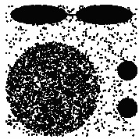
CURE algorithm
Experimental results
Experiment with data sets of two dimensions
Consists of on big and two small circles and two ellipsoid shapes connected
9/15

Slide 11
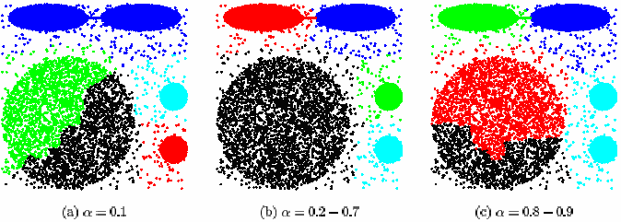
CURE algorithm
Experimental results
Shrink Factor α:
0.2 – 0.7 is a good range of values for α
10/15

Slide 12
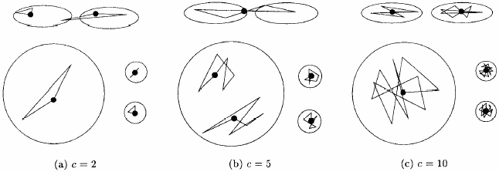
CURE algorithm
Experimental results
Number of representative points c:
For smaller values of c, the quality of clustering suffered
For values of c greater than 10, CURE always found right clusters
11/15

Slide 13
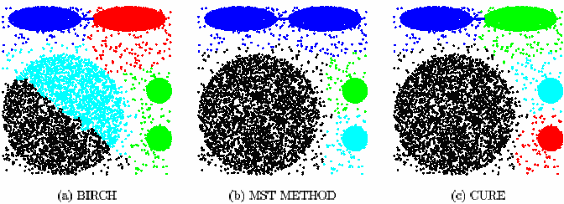
CURE algorithm
Experimental results
BIRCH cannot distinguish between the big and small clusters
MST merges the two ellipsoids
CURE successfully discovers the clusters
12/15

Slide 14
Conclusion
Can detect cluster with non-spherical shape and wide variance in size using a set of representative points for each cluster
Have a good execution time in presence of large database using random sampling and partitioning methods
Works well when the database contains outliers
13/15

Slide 15
References
Sudipto Guha, Rajeev Rastogi, Kyuseok Shim
Cure: An Efficient Clustering Algorithm for Large Databases. InformationSystems, Volume 26, Number 1, March 2001
14/15

Slide 16
Q&A
15/15

